Slide 1
Data Structure and Algorithm – PCCP D&A Team Tech Talk Speaker : Nguyen Thi Binh An

Slide 2
Outline
Introduction
DSA Common Roadmap
PCCP Focused

Slide 3
Introduction

Slide 4



Who is involved ?

Slide 5

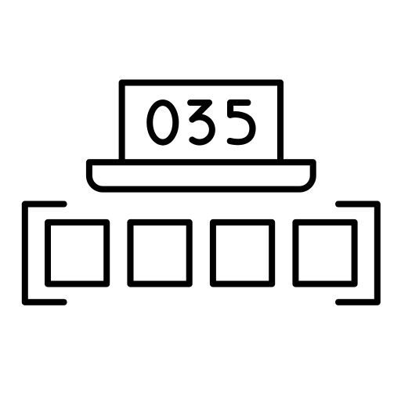


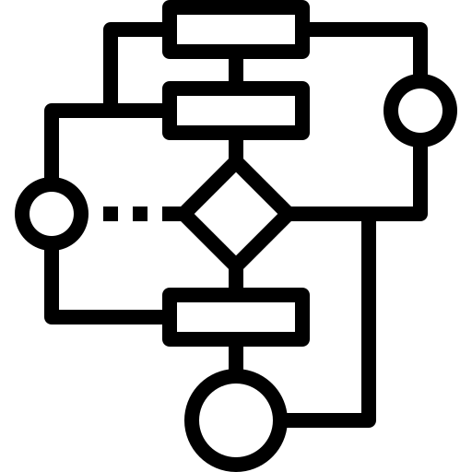
What is it?

Slide 6




Where is applied ?

Slide 7



When is used ?

Slide 8




Why it needed?

Slide 9
DSA Common Roadmap

Slide 10
Core Concepts
Data Structures
Array
Stack / Queue
Hash Map
Graph
Tree
Programing Skills
Logic Operations
Loop
Conditional
Function
Pointer
…

Slide 11
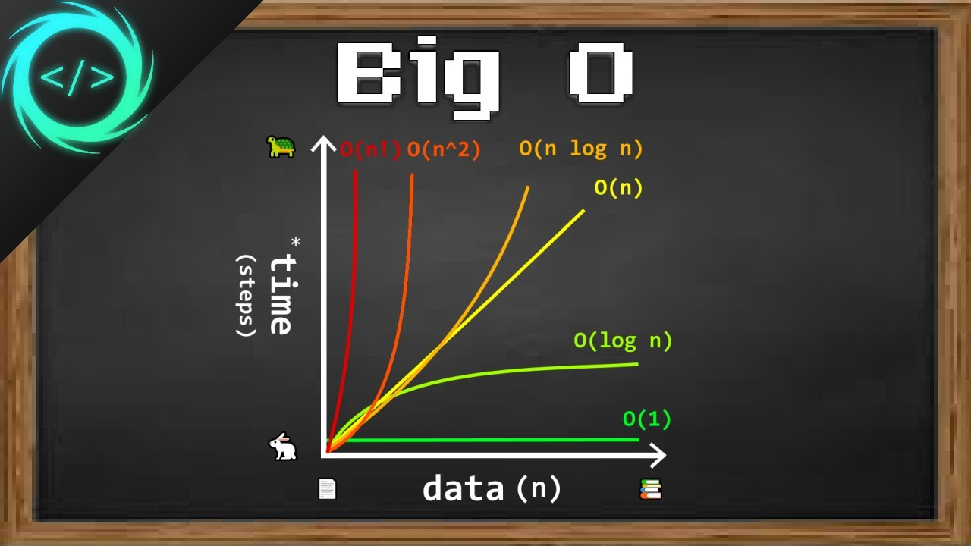
Core Concepts

Slide 12
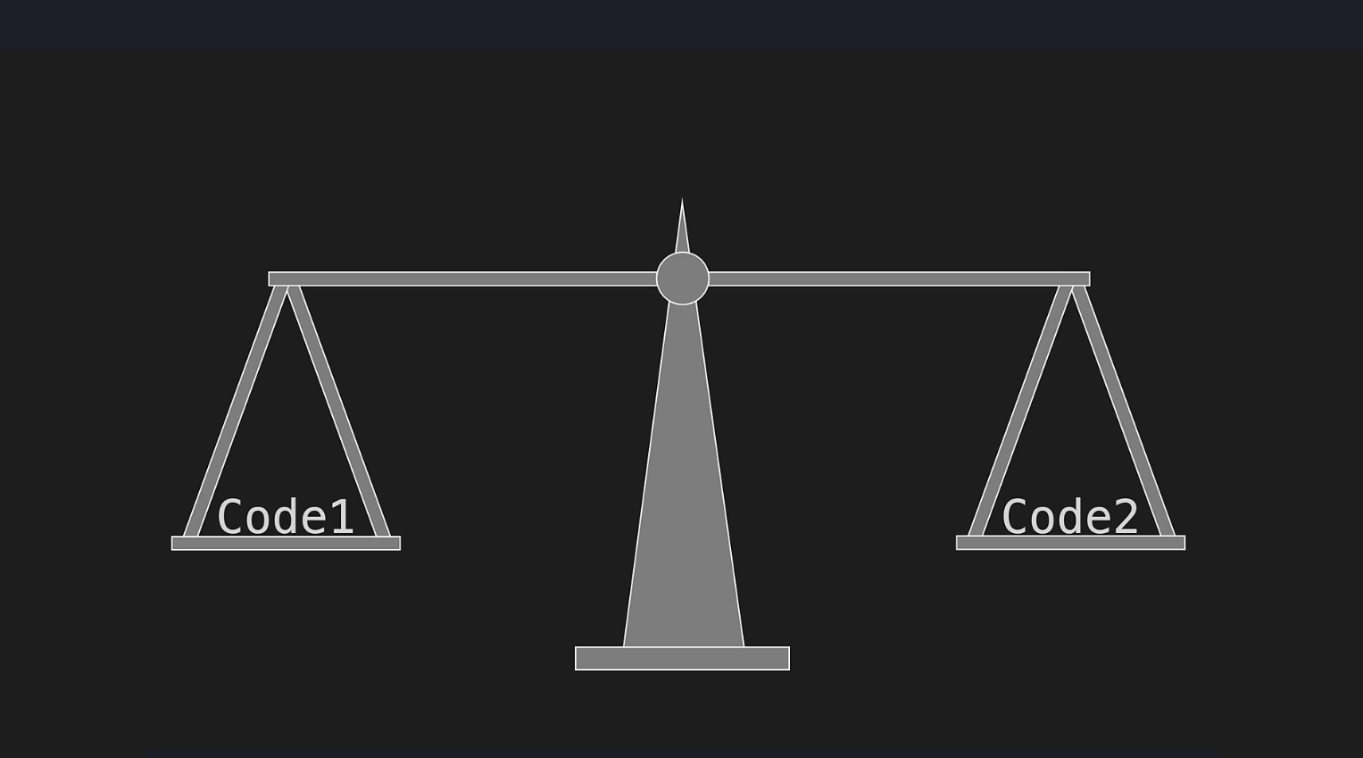

Slide 13



Simple Demo
10 | 11 | 12 | 13 | 14 | 15 | 16 | 18 | 19 | 20
Best Case
9
10
15
20
Linear Search
Worst Case
Binary Search
Average

Slide 14
Core Concepts
Programing Skills
Data Types
Logic Operations
Loop
Conditional
Function
Pointer
Recursion
…
Data Structures
Array
Linked List
Stack / Queue
Hash Map
Graph
Tree

Slide 15




Simple Demo
Array
Linked List

Slide 16






Simple Demo
Stack
Queue

Slide 17
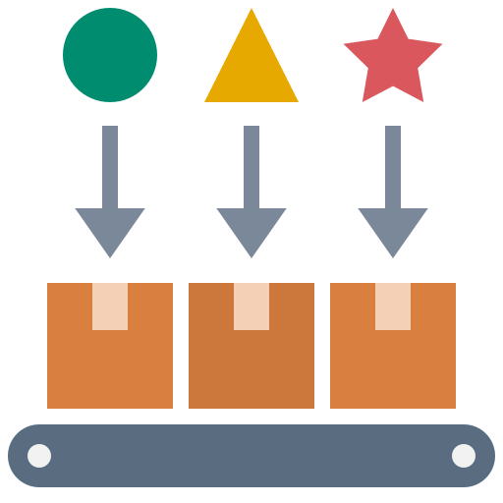
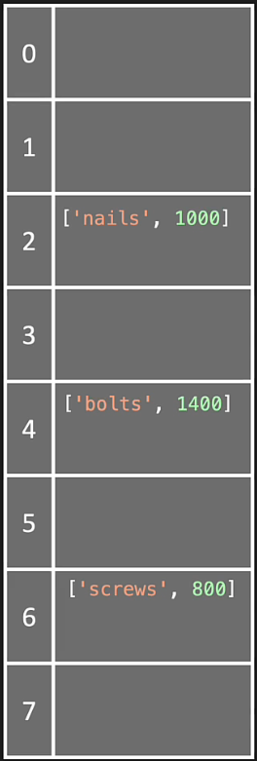
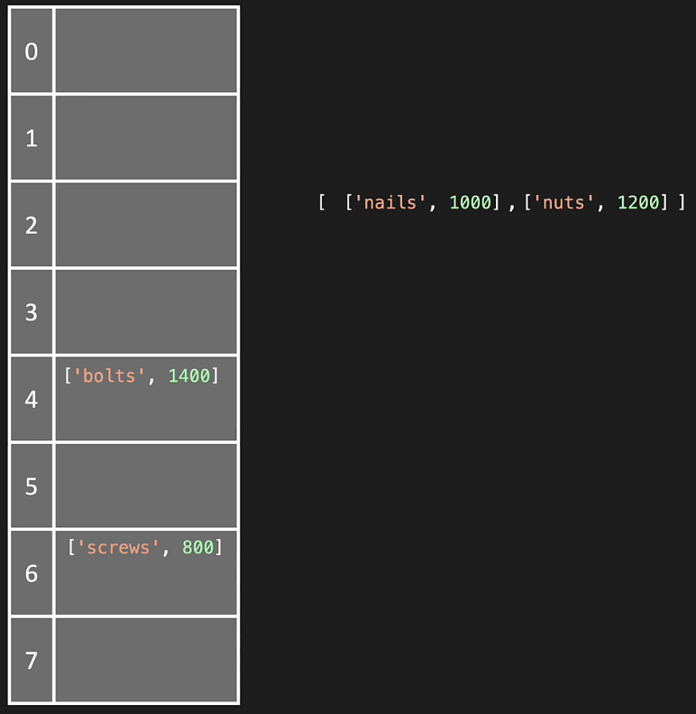
Simple Demo
Hash Map

Slide 18
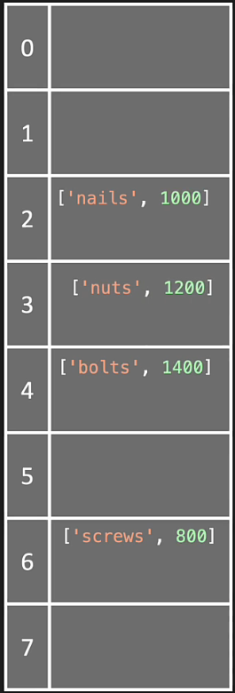
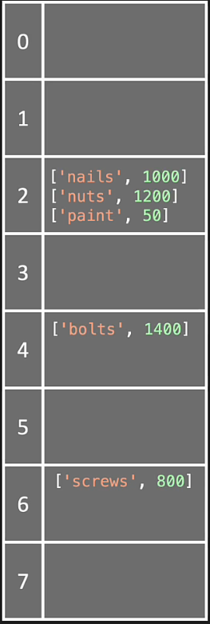
Simple Demo
Hash Map – Linear Probing
Hash Map – Separate chaining

Slide 19
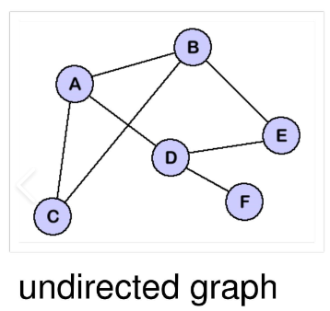
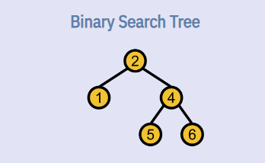
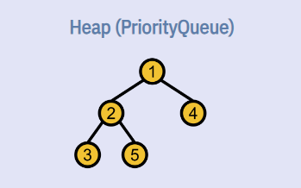
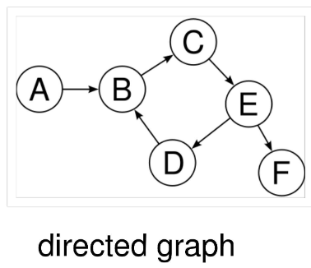
Simple Demo
Graph
Tree

Slide 20
Core Algorithms
Greedy
Sorting techniques
Searching
Graph Traversal
Dynamic Programming
…

Slide 21

Simple Demo
Greedy
Minimum Number of Operations to Make Elements in Array Distinct – LeetCode

Slide 22

Simple Demo
Sorting
Majority Element – LeetCode
Merge Sorted Array - LeetCode

Slide 23

Simple Demo
Searching
Search in Rotated Sorted Array - LeetCode

Slide 24
Simple Demo
Graph Traversal
Pacific Atlantic Water Flow – LeetCode

Slide 25
Simple Demo
Dynamic Programing
Climbing Stairs – LeetCode
Coin Change - LeetCode

Slide 26
PCCP Focused

Slide 27

Overview
Programmer Coding Competency Certification
Way for LG CNS validating coding competence
Focus on problem solving (DSA)
Paint points
Code on web browser without IDE
Just provide sample cases
Require requirements analysis, coding, testing, debug skills

Slide 28

Contest Scope
4 problems in 2 hours
1st and 2nd : Just ad-hoc or Brute Force is enough, but requirements analysis is mandatory
3rd : 1 algorithm also debugging required
4th: The most difficult, might need 2 algorithms
English/Korean reading skill needed
Data Structures and Algorithms:
Array / String / Greedy / Sorting
Stack / Queue / Deque / Hash / Binary Search / DFS – BFS
Graph / Tree / Heap / Dynamic Programming

Slide 29

Personal Experience
Screen Recorder and Camera have to turn on
Double check network condition
You have 1 white paper for drafting
Console Log for debugging
Brute Force if possible (accept all cases is not required)
Figure out the way to handle problem base on required input
Start with small cases for thinking
Limit line of codes (you can not debug over 100 LoCs)
Used algorithm: Graph Traversal, Dynamic Programming

Slide 30

Learning Resources
DSA courses on Udemy …
LeetCode / NeetCode / Hacker Rank …
PCCP Guide / PCCP Training on Wire-Wiki …
Practicing Strategy
Block Time Scope for each problem
Join PCCP mock test / LeetCode contest .. about 2 hours
Follow road map. Try with Easy Problem first
At least 1 problem a day. Consistency is needed
It’s OK to use AI as long as you get the solution

Slide 31

In house Wire-Wiki Resource | Hours (at least) to complete
PCCP Guide – Mr. Dao Van Trong | 0.5
PCCP Training – Mr. Nguyen Thanh Tung | 10
DSA 2025 – CX Team | 0.5
PCCP Training – Mr. Nguyen Dinh Anh Tung | 0.5
PCCP 2024 Experience – me, haha | 0.1

Slide 32
Thank you
Nguyen Thi Binh An
D&A Development Team
Data Service & Business Part
an.ntb@lgcns.com

